Slide 1


The New Highway Capacity Manual 6th Edition
It’s Not Your Father’s HCM
Tom Creasey, PE, PhD
Principal, Stantec Consulting Services Inc.
Chair, TRB Highway Capacity and Quality of Service Committee
Presented at the 2016 ACEC-KY/FHWA/KYTC Partnering Conference
September 7, 2016

Slide 2
We just published an update in 2010. Why another one?
Need for new research
  Changes in driver behavior, vehicle fleet mix & capabilities, analytical methods, performance measures
New research since 2010 – truck analysis, managed lanes, reliability, alternative intersections, planning applications
Available funding (including SHRP2)

Slide 3
Highway Capacity Manual Sixth Edition
Formal Title:
A Guide for Multimodal Mobility Analysis

Slide 4
Basis for the Name Change
Likely individual chapter updates in the future instead of waiting for critical mass to accumulate
Paradigm shift of delivery medium and version control
Emphasis on mobility in its 4 dimensions – quantity of travel, quality of travel, accessibility, & capacity

Slide 5
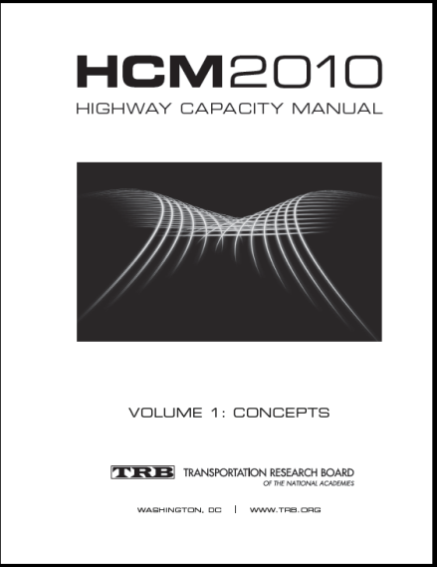

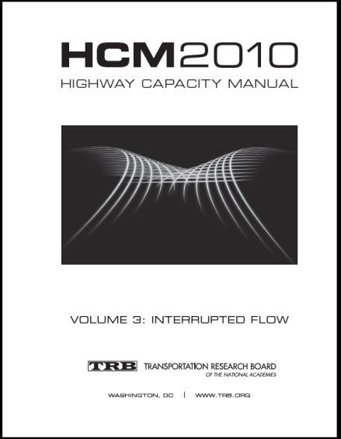
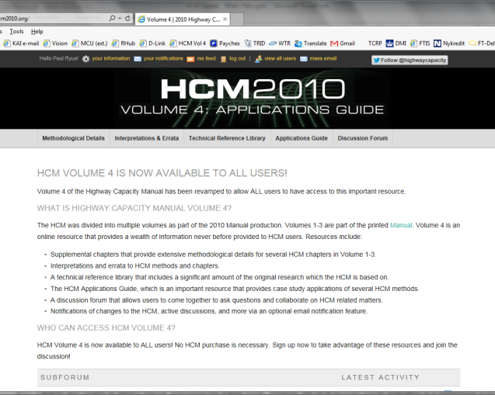
6th Edition Structure – Same as 2010 HCM
Printed HCM
Online
Volume 1:
Concepts
Volume 2:
Uninterrupted Flow
Volume 3:
Interrupted Flow
Volume 4:
Applications Guide

Slide 6
First things first … Why even use the HCM?
Simulation is more accurate and therefore better, right?
Methods in the HCM have become too complex.
Methods in the HCM are too limited.
The Manual has become too large – Who has time to read all of that?

Slide 7
Why we should be using the HCM (or using it more frequently)
Justifiable results using methods developed through research
Range of applications – planning, preliminary engineering, design, operations, performance monitoring
Some things you cannot do (or do easily) using simulation

Slide 8
HCM 6th Edition Features
Freeway Facilities Method
Reliability
Multimodal Analysis of Urban Streets
Managed Lanes/Active Traffic Demand Management (ATDM)
Work Zones
Planning & Preliminary Engineering Applications Guide

Slide 9

Freeway System Components
Off
Basic
Weave
Basic
On
Off
Basic
On
Historically, these have been evaluated independently – Basic Freeway Segments, Weaving Sections, Ramp Merge/Diverge
Inability to account for impacts of one element on others
Notes:
May be best to discuss off-slide
Access Point Request Document:
“VISSIM was used to ensure the recommended alternative works as anticipated. Included … are No-Build and Build VISSIM videos. These videos can be utilized by the reader to obtain a visual comparison of the alternatives.”

Slide 10
Freeway Facilities Method
Segment
Queue propagation upstream
Section
Notes:
Successive time periods; traffic demand rises, peaks, then falls

Slide 11
Reliability
Notice of Proposed Rulemaking (NPRM) on Performance Measures (Federal Register, April 22, 2016)
Proposed requirement to include a Travel Time Reliability measure in system management and performance monitoring

Slide 12
More on Reliability
Historically, HCM methods have reflected average or “typical” scenarios
Much more variability in “real world”

Slide 13
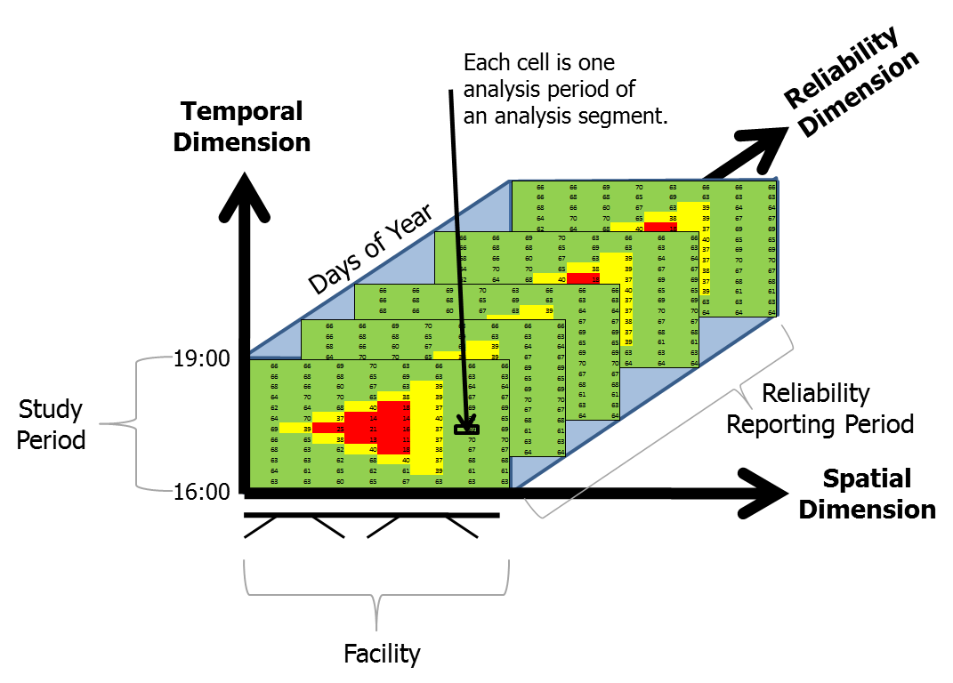
Freeway Reliability Analysis
Applies Freeway Facilities method repeatedly with adjusted demands, capacities, lanes, and free-flow speeds to develop a travel time distribution
Incorporates demand variation, weather, incident, work zone, and special event effects
Produces a variety of useful reliability-related performance measures
Similar method for Urban Streets
Freeway method also evaluates effects of ATDM strategies

Slide 14
Urban Streets Method
Multimodal – LOS for autos, bicyclists, pedestrians and bus riders
Urban street evaluated as a facility
New method for evaluating spillback
Includes intersections with interchange ramp terminals (Diamond, ParClo, SPUI, and DCD/DDI)
Adjustment factors for work zones, mid-segment blockage and downstream spillback

Slide 15
Managed Lanes/Active Traffic and Demand Management (ATDM) Strategies
HOT/HOV Lanes
Reversible Express Lanes
Bus Lanes
Speed Harmonization
Temporary Shoulder Use
Ramp Metering

Slide 16
Freeway Facilities Method Applied to Managed Lanes and Other ATDM Strategies

Slide 17
Work Zones
New Freeway method for evaluating work zones effects on capacity
Urban Streets method provides adjustments to saturation flow rates for mid-block segments and at signalized intersections
Procedure for predicting segment queue spillback
Work zone activity a key variable in travel time reliability estimation

Slide 18

Planning and Preliminary Engineering Applications Guide to the HCM
NCHRP Research Project 7-22
Research Team
  Kittelson & Associates, Inc.
    Richard Dowling (PI)
    Paul Ryus
  ITRE/North Carolina State University
    Bastian Schroeder
  Stantec
    Tom Creasey
  University of Idaho
    Michael Kyte
REPORT 825
Planning and Preliminary
Engineering Applications Guide
to the Highway Capacity Manual

Slide 19

Purpose of the Guide
The HCM is commonly used by transportation agencies to evaluate current or projected operations
The HCM also can reliably and cost-effectively support:
  Planning efforts
  Programming decisions
  Performance monitoring
  Roadway management
Bringing the “back of the envelope” back

Slide 20
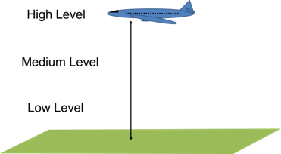
Levels of Planning Analysis
High level
  Large analysis area
  Low detail
Medium level
  Focus on a single roadway
  facility, segment, or
  intersection
  Greater detail
Low level
  Highly focused and highly detailed

Slide 21
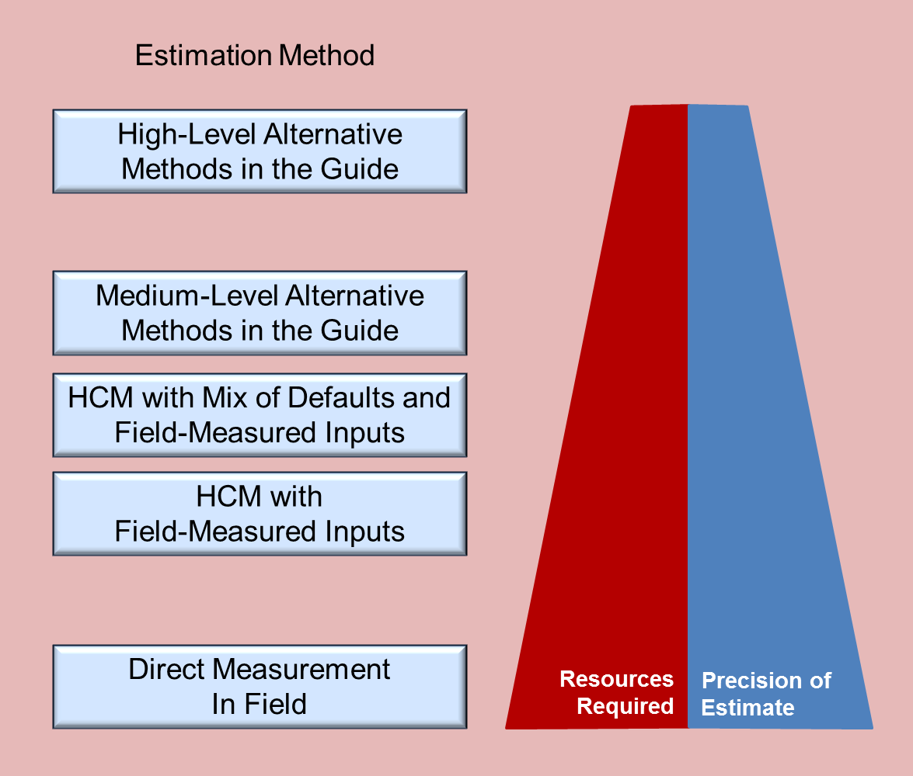
Relative Detail of HCM-Based Analysis Methods

Slide 22
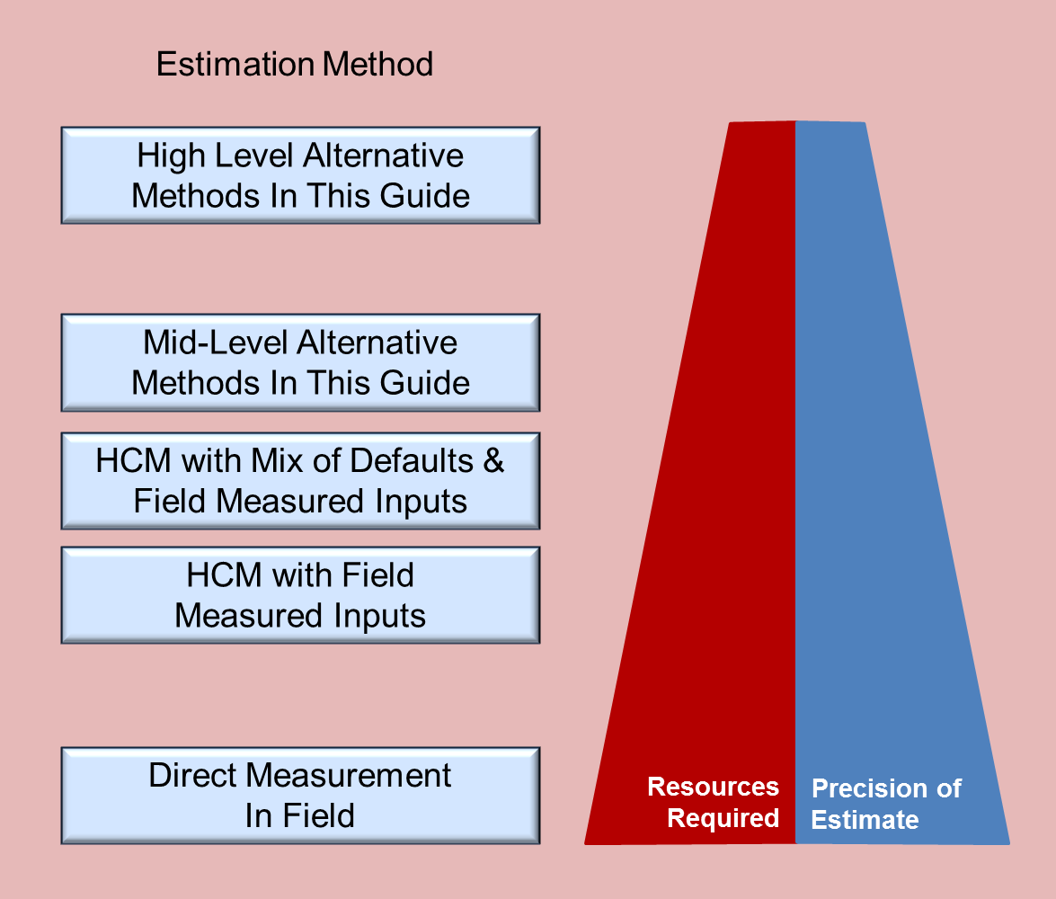
Focus of the Guide

Slide 23
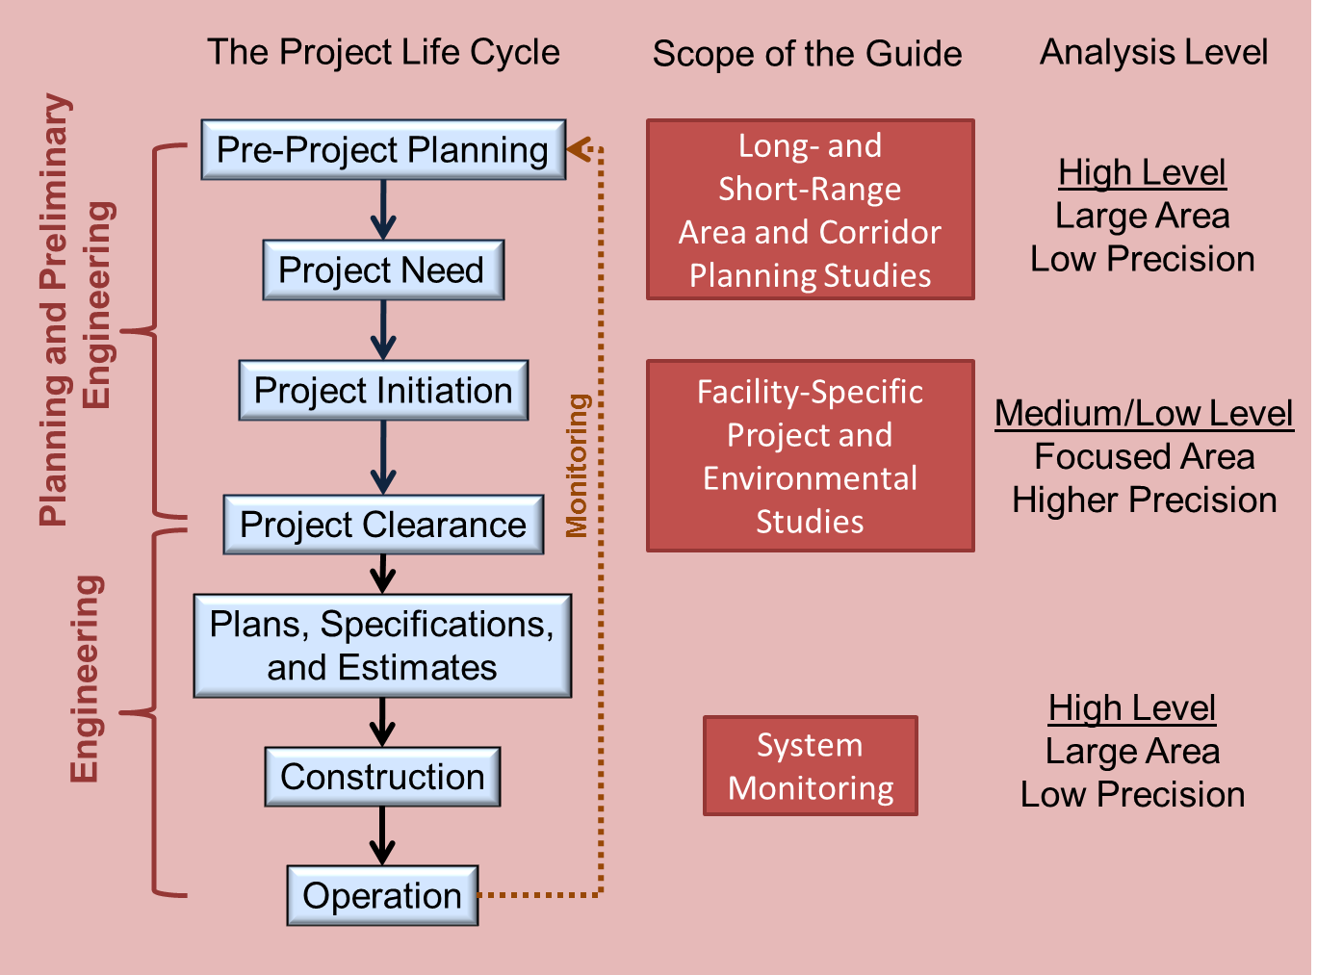
Guide’s Relationship to the Planning Process

Slide 24
Areawide Transportation Planning Tasks Addressed in the Guide
Areawide Planning Analysis Task | Part 3 Reference | Part 4 Case Study
Input to travel demand models
Estimate highway segment capacities and free-flow speeds | Section R | Case Study 3.1
Traffic assignment module within the travel demand model
Apply volume–delay functions to estimate congested speeds | Section R | Case Study 3.2
Post-processing travel demand model outputs
Obtain more accurate speed estimates for air quality analyses | Section R | Case Study 3.3
Spot auto volume-to-capacity and level of service hot spots (quick screening) | Section R | Case Study 3.3
Estimate delay based on agency policy | Section R | Case Study 3.3
Estimate queuing | Section R | Case Study 3.3
Interpret results | Section R | Case Study 3.3
Analyze travel time reliability | Section R | Case Study 3.4
Estimate multimodal quality of service for autos, trucks, transit, bicycles, and pedestrians | Section R | None
Corridor analyses | Section Q | None

Slide 25
Screening and Scoping Tasks Addressed in the Guide
Screening and Scoping Task | Parts 2 and 3 References | Part 4 Case Studies
Identify potential level of service (LOS) hot spots
Screen for auto LOS problems | Sections H-N | Case Studies 1.4, 2.4
Screen for truck LOS problems | Section P | None
Screen for transit, bicycle, and pedestrian LOS problems | Section O | Case Study 2.6
Identify potential capacity problems: auto | Sections H-N | Case Studies 1.1, 1.2, 2.1, 2.2, 2.3
Preliminarily evaluate improvement alternatives
Auto improvements | Sections H-N | Case Study 1.7
Truck improvements | Sections H-N | None
Transit, bicycle, and pedestrian improvements | Section O | Case Study 2.6

Slide 26
Medium-Level Analysis Tasks Addressed in the Guide
Project Impact and Alternatives Analysis Task | Parts 2 and 3 Reference | Part 4 Case Studies
Input to travel demand models (if used)
Estimate highway capacities and free-flow speeds | Section R | Case Study 3.1
Traffic assignment module within travel demand model (if used)
Apply volume–delay functions for estimating congested speeds | Section R | Case Study 3.2
Input to microsimulation model (if used)
Estimate free-flow speeds | Sections H-N | None
Microsimulation model validation and error checking (if used)
Estimate capacity for error checking simulated bottlenecks | Sections H-N | None
Project impact and alternatives analyses
Estimate segment speeds for air quality and noise analyses | Sections H-N | Case Studies 1.3, 2.4
Estimate auto intersection utilization (v/c ratios) | Sections H-N | Case Studies 2.2, 2.3
Estimate delay | Sections H-N | Case Study 2.4
Estimate queuing | Sections H-N | Case Studies 1.5, 2.5
Interpret results | Sections H-N | Case Studies 1, 2
Analyze travel time reliability | Sections H, K | Case Study 1.6
Estimate multimodal quality of service for transit, bicycles, and pedestrians | Section O | Case Study 2.6
Estimate truck level of service | Section P | None
Corridor analyses | Section Q | None

Slide 27
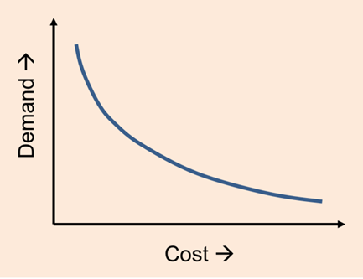
Working with Traffic Demand Data
Overview
Selecting an analysis hour
Converting daily volumes to
shorter timeframes
Seasonal adjustments to traffic volumes
Rounding traffic volumes
Observed volumes vs. actual demand
Constraining demand for upstream bottleneck metering
Converting link volumes to turning movements
Notes:
Section D describes methods for working with traffic volume data, both actual counts and estimates produced by travel demand models. This section recognizes that state and local transportation agencies may have already established specific traffic forecasting and analysis guidelines and policies and recommends that analysts remain consistent with those policies, where they exist. The guidance in this section can be applied in the absence of agency policies, and can also be considered when agencies update their policies.

Slide 28
Daily Service Volume and Capacity Tables – Urban Streets
K- | D- | Two-Lane Streets |  |  | Four-Lane Streets |  |  | Six-Lane Streets
Factor | Factor | LOS C | LOS D | LOS E | LOS C | LOS D | LOS E | LOS C | LOS D | LOS E
Posted Speed Limit = 30 mph
0.09 | 0.55 | 1,700 | 11,800 | 17,800 | 2,200 | 24,700 | 35,800 | 2,600 | 38,700 | 54,000
0.09 | 0.60 | 1,600 | 10,800 | 16,400 | 2,000 | 22,700 | 32,800 | 2,400 | 35,600 | 49,500
0.10 | 0.55 | 1,600 | 10,700 | 16,100 | 2,000 | 22,300 | 32,200 | 2,400 | 34,900 | 48,600
0.10 | 0.60 | 1,400 | 9,800 | 14,700 | 1,800 | 20,400 | 29,500 | 2,200 | 32,000 | 44,500
0.11 | 0.55 | 1,400 | 9,700 | 14,600 | 1,800 | 20,300 | 29,300 | 2,100 | 31,700 | 44,100
0.11 | 0.60 | 1,300 | 8,900 | 13,400 | 1,700 | 18,600 | 26,900 | 2,000 | 29,100 | 40,500
Posted Speed Limit = 45 mph
0.09 | 0.55 | 7,700 | 15,900 | 18,300 | 16,500 | 33,600 | 36,800 | 25,400 | 51,700 | 55,300
0.09 | 0.60 | 7,100 | 14,500 | 16,800 | 15,100 | 30,800 | 33,700 | 23,400 | 47,400 | 50,700
0.10 | 0.55 | 7,000 | 14,300 | 16,500 | 14,900 | 30,200 | 33,100 | 23,000 | 46,500 | 49,700
0.10 | 0.60 | 6,400 | 13,100 | 15,100 | 13,600 | 27,700 | 30,300 | 21,000 | 42,700 | 45,600
0.11 | 0.55 | 6,300 | 13,000 | 15,000 | 13,500 | 27,500 | 30,100 | 20,900 | 42,300 | 45,200
0.11 | 0.60 | 5,800 | 11,900 | 13,800 | 12,400 | 25,200 | 27,600 | 19,100 | 38,800 | 41,500

Slide 29
A Very General Service Volume Table

Slide 30

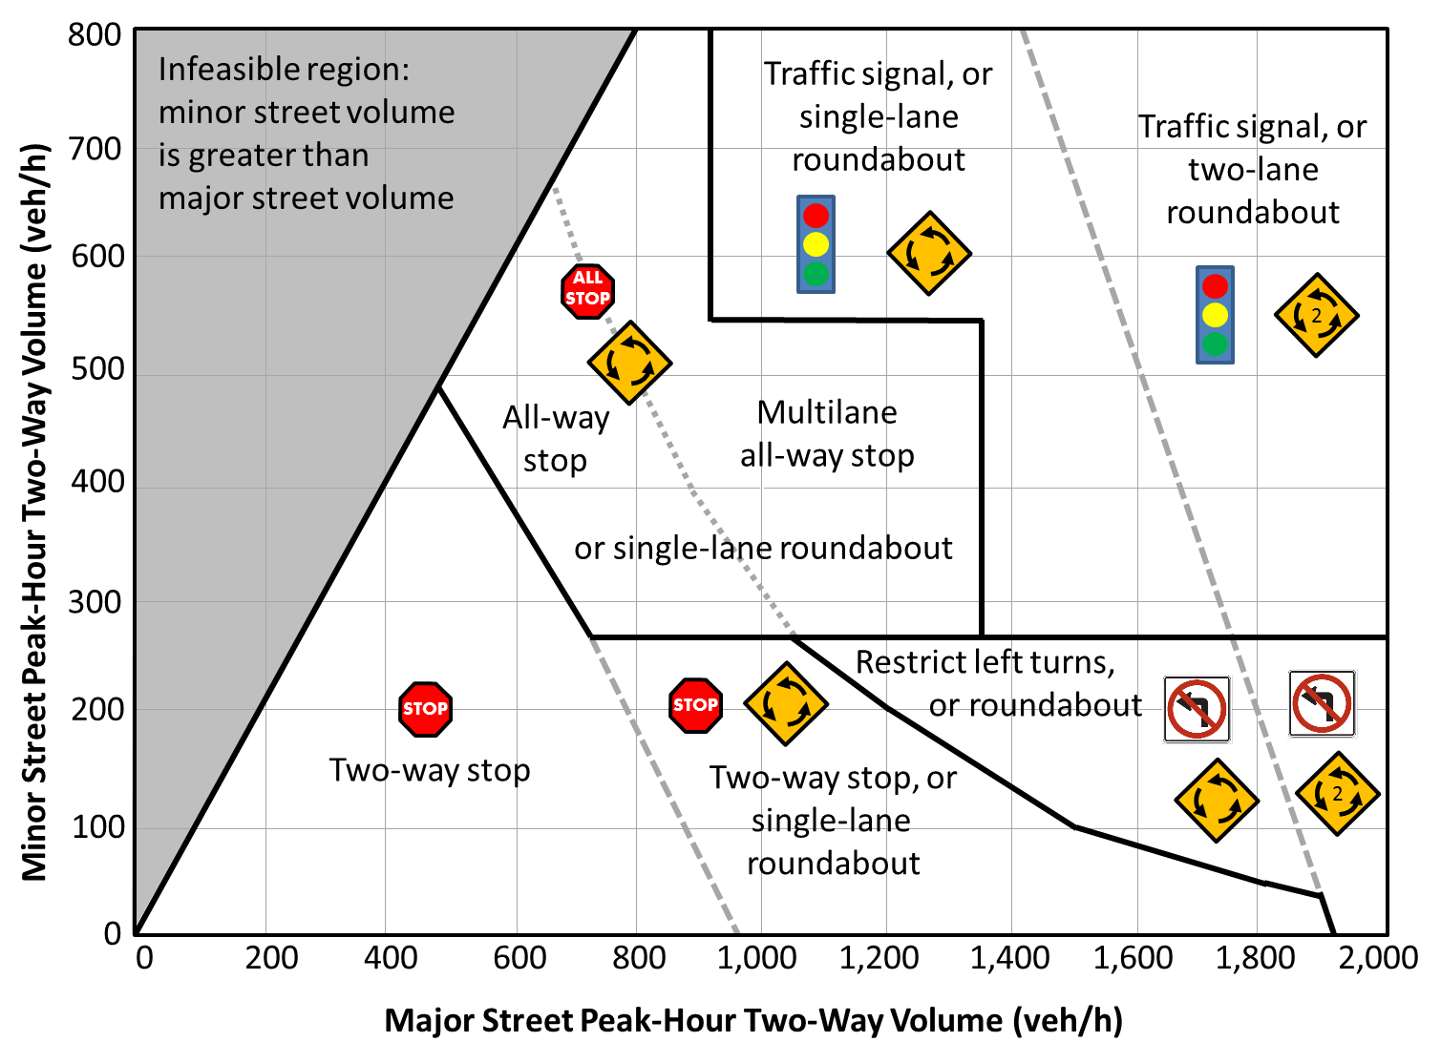
Predicting Intersection Traffic Control
Overview
Manual on Uniform Traffic
Control Devices (MUTCD)
  Estimating 8th- and 4th-
  highest hour volumes
  Applying MUTCD warrants
Graphical method
  Identifies likely future
  intersection control for
  use in a planning analysis
Notes:
Analyzing the operation of an urban street using the HCM requires some knowledge of the type of traffic control used at the intersections along the street. In a planning or preliminary engineering analysis, these decisions may not have been made yet, or the purpose of the analysis may be to determine the likely form of traffic control to be used in the future. Section E provides methods for predicting what the intersection traffic control may be, given estimates of the major and minor street traffic volumes and the directional distribution. This section recognizes that state and local policies may specify the conditions under which particular types of intersection traffic control should or should not be considered, and states that these policies should supersede the guidance presented in Section E.

Slide 31
Roadway System Monitoring
Guidance on identifying and
diagnosing travel-time reliability
and capacity problems
Method assumes that the
agency has access to archived
average travel times by road segment and time of day
The travel time index, the ratio of actual to free-flow travel time, is a useful indicator of congestion problem spots
Florida DOT
Notes:
Section D describes methods for working with traffic volume data, both actual counts and estimates produced by travel demand models. This section recognizes that state and local transportation agencies may have already established specific traffic forecasting and analysis guidelines and policies and recommends that analysts remain consistent with those policies, where they exist. The guidance in this section can be applied in the absence of agency policies, and can also be considered when agencies update their policies.

Slide 32
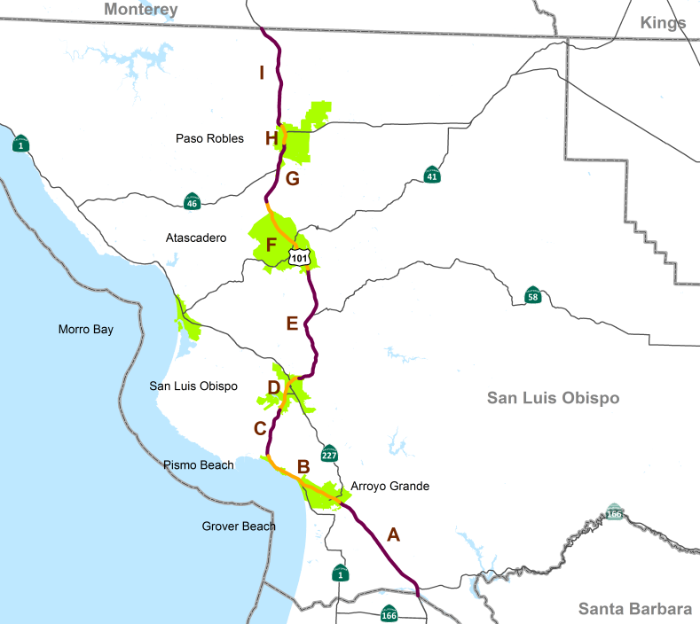
Case Studies
Freeway Master Plan
  V/C screening of critical
  segments
  Prediction of speeds/travel
  times
  Queuing estimation
  System MOEs
Arterial Bus Rapid Transit
  Multimodal Urban Street planning methods
  Planning-level signalized intersection analysis
  Trade-offs among various multimodal improvements
Notes:
Section D describes methods for working with traffic volume data, both actual counts and estimates produced by travel demand models. This section recognizes that state and local transportation agencies may have already established specific traffic forecasting and analysis guidelines and policies and recommends that analysts remain consistent with those policies, where they exist. The guidance in this section can be applied in the absence of agency policies, and can also be considered when agencies update their policies.

Slide 33
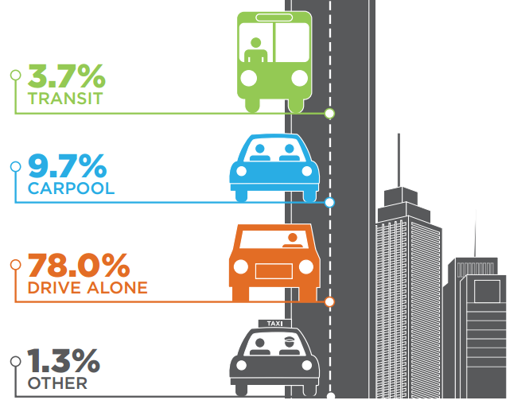
Case Studies (cont.)
Long Range Transportation Plan
  FFS, Capacities for Model Input
  HCM-based Volume-Delay Functions
  Generalized Service Volume Tables
  Predicting Reliability
Notes:
Section D describes methods for working with traffic volume data, both actual counts and estimates produced by travel demand models. This section recognizes that state and local transportation agencies may have already established specific traffic forecasting and analysis guidelines and policies and recommends that analysts remain consistent with those policies, where they exist. The guidance in this section can be applied in the absence of agency policies, and can also be considered when agencies update their policies.

Slide 34
HCM vs. Simulation
Simulation remains an important tool, we can do a lot more with HCM than some people think
In some cases, HCM is a better tool than simulation
HCM 6th Edition gives us an even more robust tool set, the extent of which we’ve never had before

Slide 35
Thank you!
Acknowledgements
NCHRP 3-115, Production of a Major Update to the 2010 Highway Capacity Manual
NCHRP 7-22, Planning and Preliminary Engineering Applications Guide to the Highway Capacity Manual

